Slide 1
Midterm Proposal
Jacqueline Wang

Slide 2
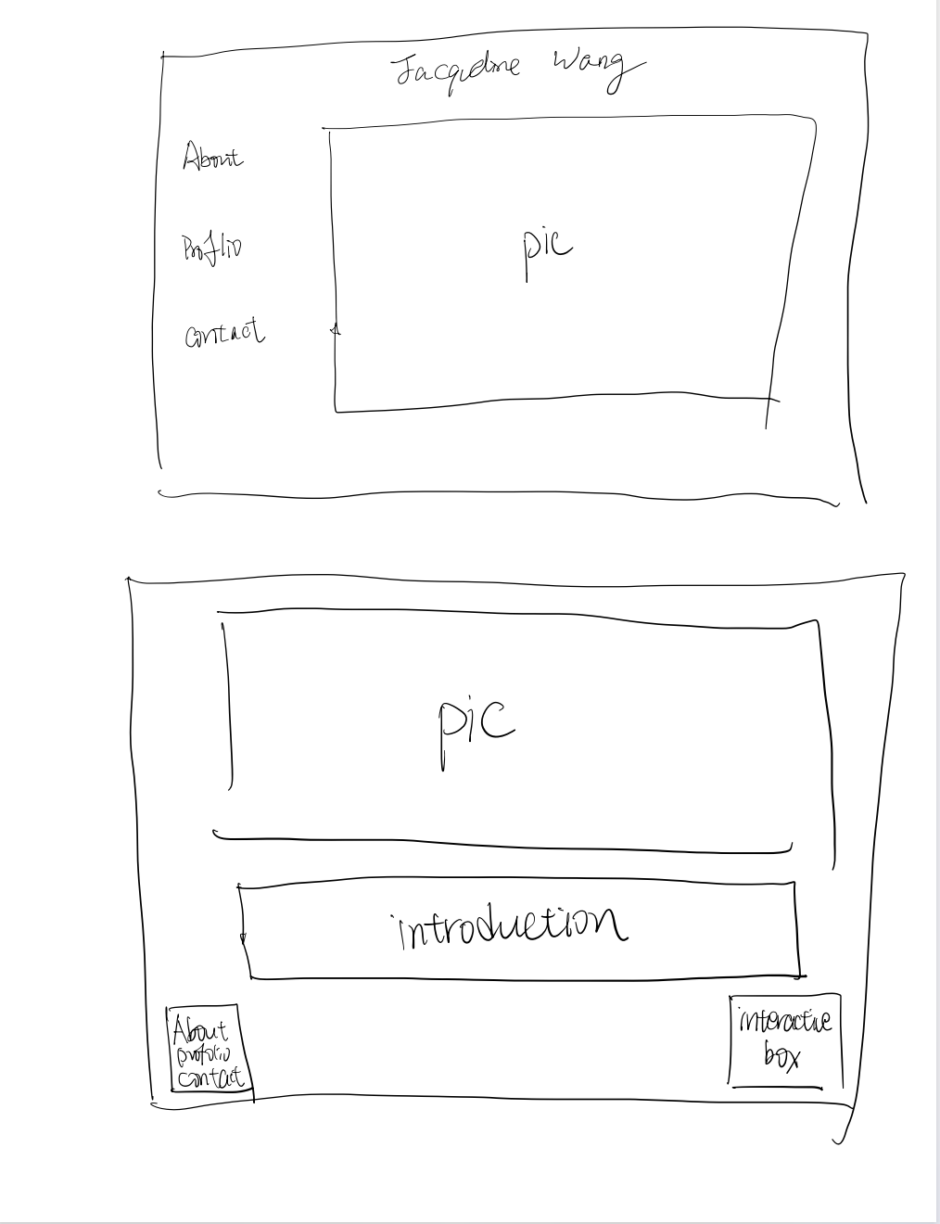
Theme
01
Profolio
show my work
Interactive

Slide 3
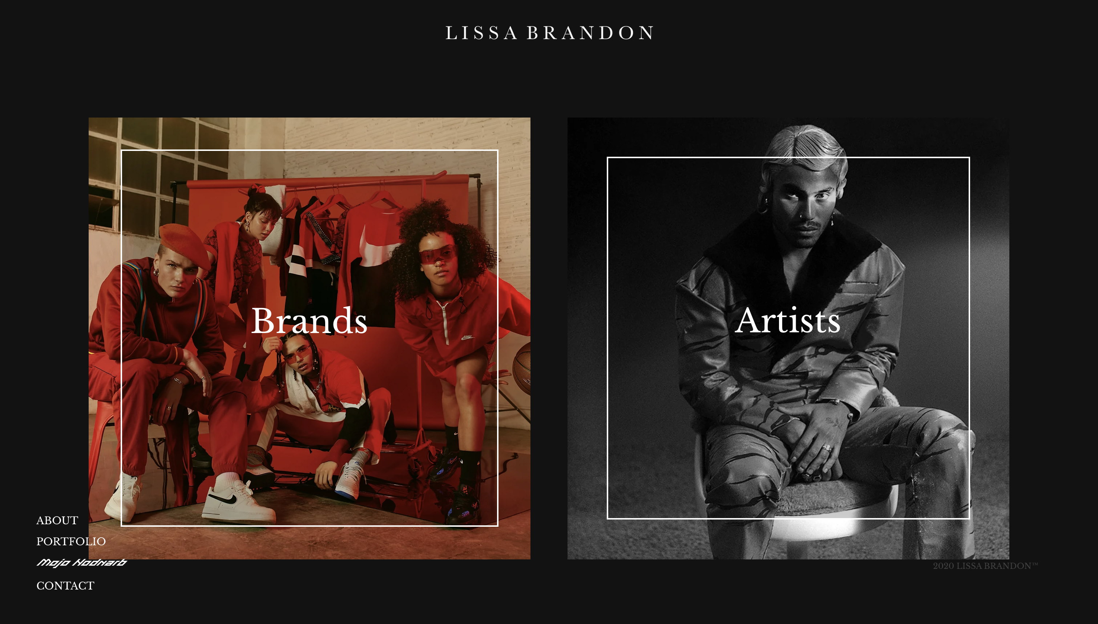
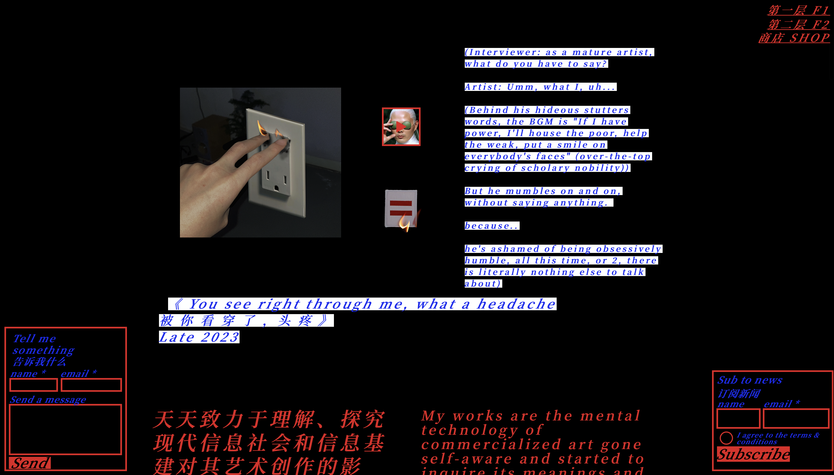
Inspiration
https://www.lissabrandon.com/about
https://www.daydaykey.com/about

Slide 4
Skills
Structure and Semantics
Forms
Media
Links and Navigation
Styling,Layouts
Custom Fonts and Icons
Transitions

Slide 5
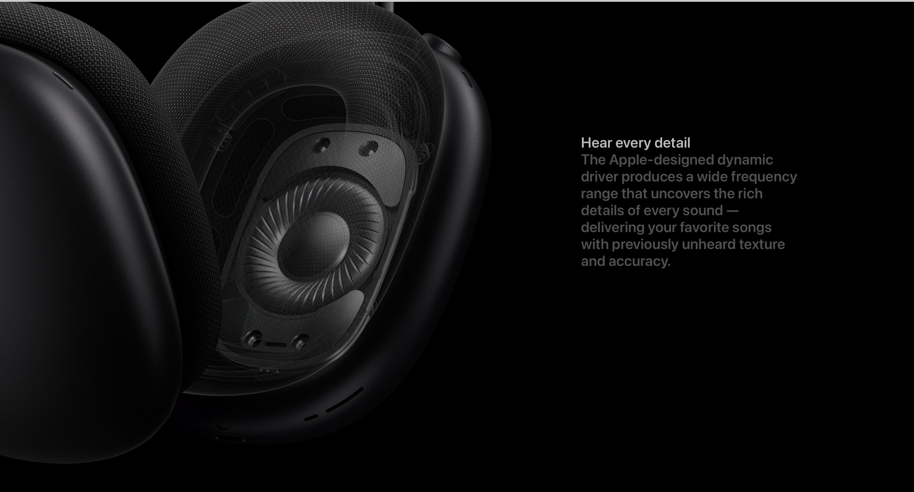
Skills
insert videos
moving images (p5js)
https://www.apple.com/airpods-max/

Slide 6
Thank you!
Jacqueline Wang

